Slide 1
Using Semantic Networks in a Web Crawler to find Stephen King novels in two Languages
By Jose A Gonzalez

Slide 2
Introduction
Search engines are majorly optimized for English, the most spoken language in the world.
While most resources on the internet are in said language, finding information in English can be particularly difficult if it is not your first language.
The aim of this project is to experiment with semantic networks to find new ways of translating queries in information retrieval.
For this particular proof of concept, the bibliography of the novelist Stephen King was used, since it’s varied and extensive.

Slide 3
Difficulties
Translating is a complicated job. Translators face challenges keeping the meaning and context of a text when changing its language, and this is turn gives users complications in finding said work.
Here are some of the reasons why simply putting a word through Google Translate may not find you what you’re looking for:
Similar Meaning, Different Word: Sometimes the sound or context of a word is more important than its specific meaning. Maybe the literal translation doesn’t convey the same feeling, or is not a well known word in the other language. Example: The novel “The Shining” should literally translate to Spanish as “El Brillo”. However, the Spanish edition of said novel are instead named “El Resplandor” (The Radiance), probably since it sounded more ominous and specific.

Slide 4
Difficulties (cont.)
Semantic Proximity: Due to copyright laws, or a lack of direct translation, some titles are changed altogether, in the best of cases elements of the original title are kept. Example: The word “Firestarter” has no direct translation in Spanish, so the title of the short novel was changed to “Ojos de Fuego” (Eyes of Fire).
Translation by Association: A word may be too common in one language compared to the other, or maybe it’s historical context is not as obvious, so a sentence with some sort of association to it is picked. Example: The short novel “The Running Man” wasn’t translated to it’s counterpart “El Corredor”, but to “El Fugitivo” (The Fugitive).

Slide 5
Implemented Solution #1 – Keeping the Original Query
In the case of Stephen King’s works we can take advantage of the popularity of the English language. Most translations and articles about them will include the title of the original work in it’s native language. By keeping the original search terms, it’s possible to find the translated equivalent of a work.
Example: Looking for “Needful Things” will rank the correct Spanish equivalent “La Tienda” (The Store) higher, even though it’s not a translation of the title.
Unfortunately, this will only be effective if the search inputted by the user is in the original language of the work they are looking for. Which is why a translation is needed.

Slide 6
Implemented Solution #2 – Adding Translated Terms to the Query
The most basic step for multilingual search is, of course, to include the translation of search terms in the query.
This is how, if we search “Ojos de Fuego” we get the novel “Firestarter”. The query is transformed into “ojos, fuego, eyes, fire” and the multiple mentions of fire are linked to the novel.
Unfortunately, this doesn’t suffice for cases where the title isn’t present in the premise of the novel, or a direct translation doesn’t represent the one used. So we need a way to introduce other possible translations to the same word.

Slide 7
Implemented Solution #3 – Semantic Networks
Adding semantically related words to the ones in the query after translation, will open a range of similar terms that might have been used to translate the term you’re looking for.
This is how we get to translate “El Resplandor” to “The Shining” even though its not a direct translation.
Unfortunately, different semantic networks will have different connections between words, and sometimes widening our area of search will harm our results instead of improving them.

Slide 8
How my Demo Works
To experiment with these concepts, I made an algorithm that searches for the Spanish and English equivalents of the Wikipedia article about a requested Stephen King work, using a basic Web Crawler. The program follows a simple structure:
Take the input
Tokenize it and remove all “stop words”
Create two lists of terms: One for English, one for Spanish.
For each list, add the translation for all the terms to the language that list represents.
For each list, add all semantically related words in the language that list represents.
Crawl from the seed of each language, looking for the documents with more mentions of the processed terms.
Score them based on frequency, and sort them.
Show them to the user.

Slide 9
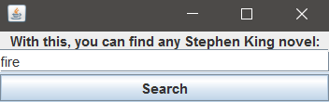
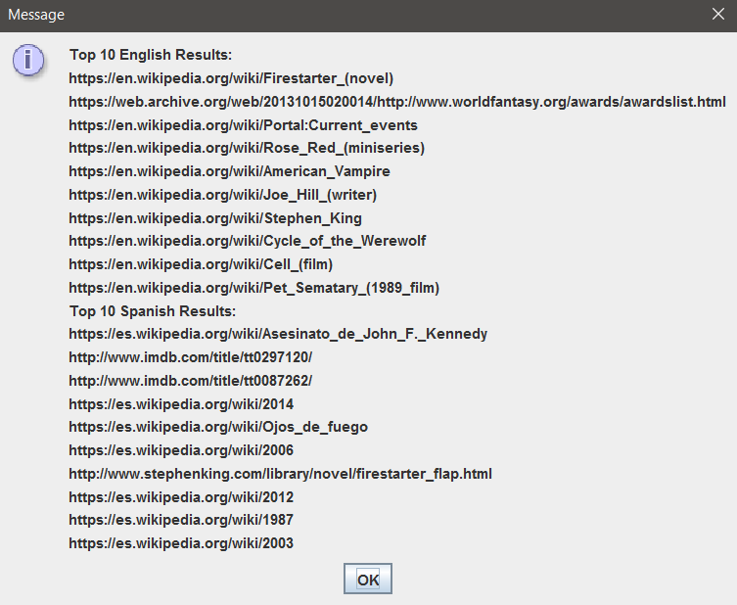

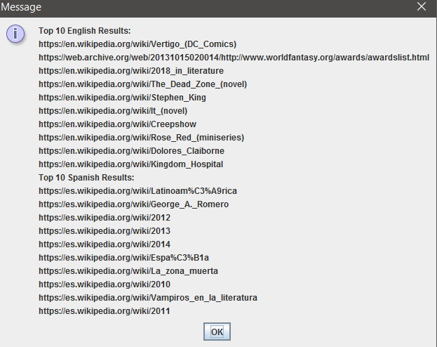

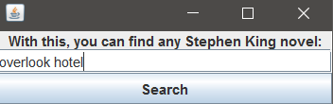
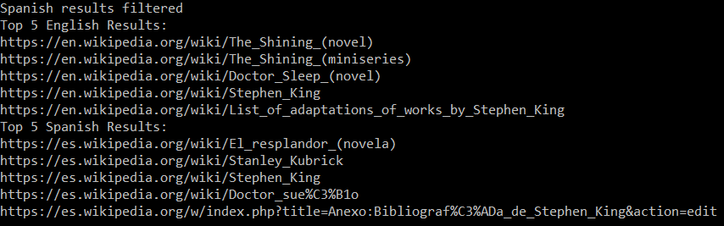

Slide 10
Tools Used
Stop Words in multiple languages can be found as easily readable documents here:
http://code.google.com/p/stop-words/
Spellchecking (both for English and Spanish) is handled with the Jortho library.
https://www.inetsoftware.de/other-products/jortho
Lexical Databases and Semantic Network used through the BabelNet API
https://babelnet.org/guide
Direct translation is done through the Google LanguageApp:
https://developers.google.com/apps-script/reference/language/language-app
however, since v1 of the Google API was deprecated and v2 is paid, a workaround had to be done using Google Script.
https://www.google.com/script/start/
Using one of the methods described here:
https://stackoverflow.com/questions/8147284/how-to-use-google-translate-api-in-my-java-application

Slide 11
Future Improvement #1 – Create a Context-sensitive Semantic Network
One of the problems encountered by implementing a semantic network is context. Two words may be related under entirely different context, making them harder to connect. Or two words may not be considered “close enough” unless the context is taken into account.
By building either a database or a semantic network that takes context into account, possibly using keywords, interpretative translation can be more accurately predicted by the search engine.
Practicality Example: Associating the term “Running Man” with “Fugitive”

Slide 12
Future Improvement #2 – Build a Database of Usage
The most popular approach used by search engine, by far, is to keep usage information from the user and take it into account to show them results related to their interest, or to calculate the popularity of certain topics and estimate the intended translation of a phrase with it.
This would allow us to discard certain semantically-related terms, or relegate their importance when calculating scores, according to the personal interests of the user or general traffic overall.
Practicality Example: Even though “The Stand” and “Apocalipsis” have no seeming relation in their title, we could directly make the connection by keeping track of the article users end up finding.

Slide 13
Future Improvement #3 – A Better Searcher Overall
Since this project was more aimed at experimenting with techniques for obtaining documents in other languages, it’s based on a very slow, inefficient, and simple web crawler.
A better structured and optimized engine, capable of ignoring redundant links and documents in languages not desired, would prevent false positives.
Another issue with this search engine is that it scores based on the total count of certain words, and not their frequency. So correct results are ignored in favor of longer articles.
An example of this last issue is how the short story “The Sun Dog” is more likely to return an article on Richard Bachman (King’s pseudonym when he wrote the story) than the corresponding article in either language.

Slide 14
Thank You for your Attention

